Slide 1


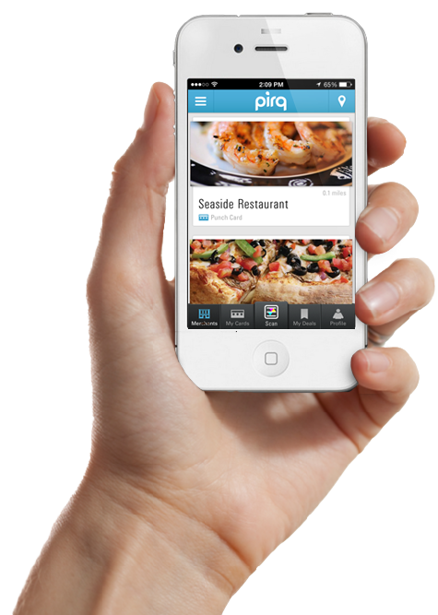
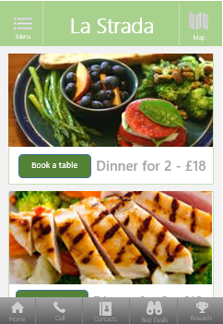
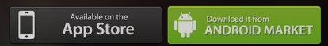

walleb
your mobile loyalty wallet
For Consumers
All your loyalty / rewards programs in one place
For Retailers
Build better relationships with your customers
Coming Soon :
A platfom as a service from

Slide 2
How it works
Retailers
Consumers
Measure results
5
Retailers measure the results of their campaign
understand better the needs of the spending profile or
their customers and prepare new campaigns
4
Make Deals and Collect Rewards
Consumers are notified for the best offers in their area
and they make deals according to the incentives
3
Register to the Walleb service
Consumers scan the QR codes with their mobile phones
and they get an e-mail to install the Walleb web app
Promote your campaign
2
Retailers promote their new mobile campaign
in their retail stores using QR codes
Subscribe and Setup your campaign
1
Retailers subscribe to the Walleb Service and they easily
setup new marketing campaigns in just a few moments

Slide 3
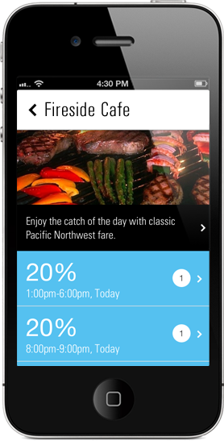
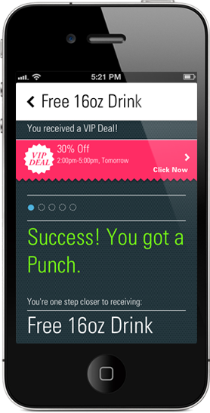
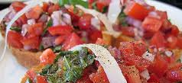

Consumer’s app
La Strada
Consumers can surf
in various deals in
their area
Adam G Coiffure
Images/media of
the offerings / deals
Typical Tuscan's cuisine >
Perfect Color Combinations >
Retailer Description
profile, services, etc
Wednesday
40% Off
Now
50 % Off
Instant Deals
Discounts, Points
and other incentives
3.30 p.m – 7.00 p.m
Until 7.00 p.m

Slide 4
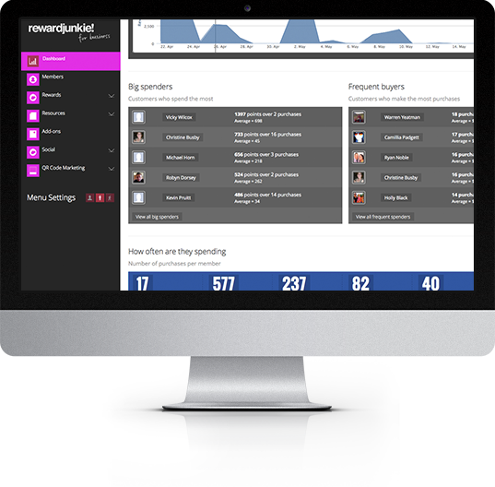
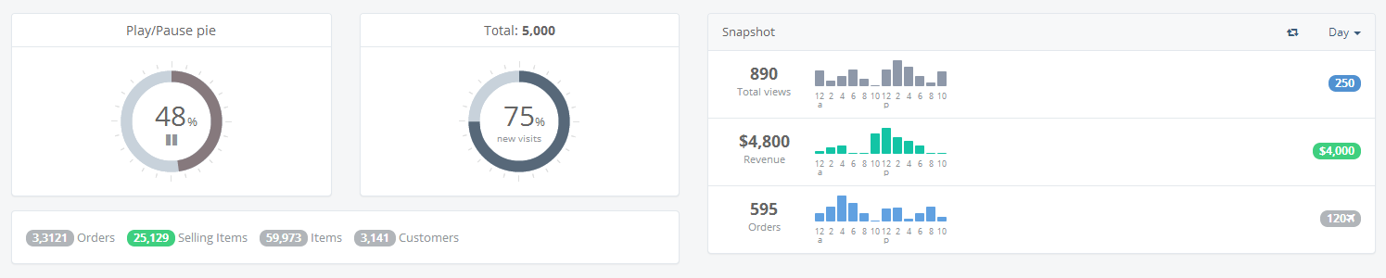

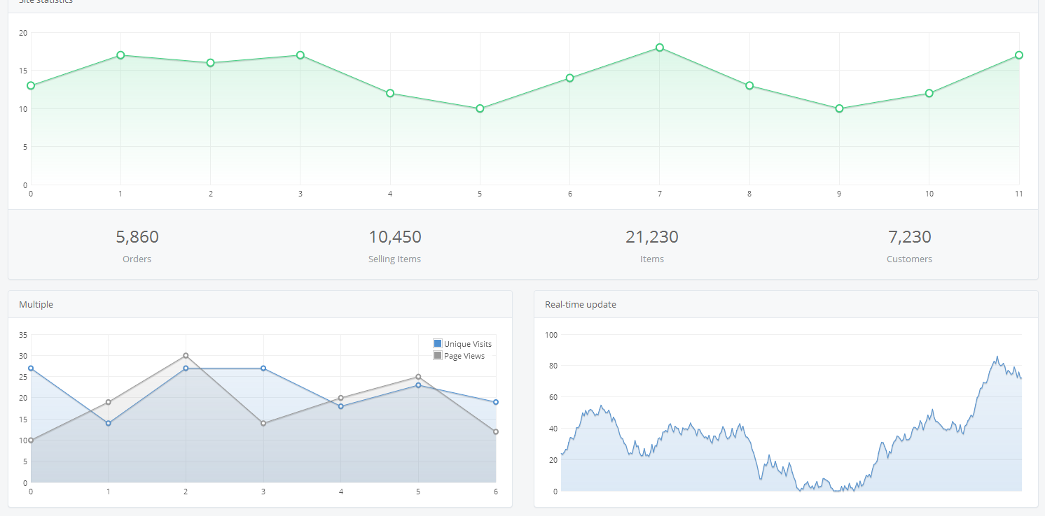



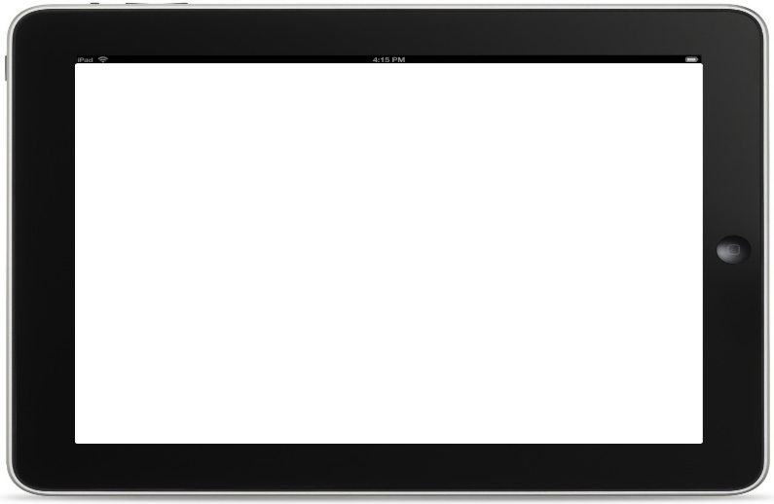
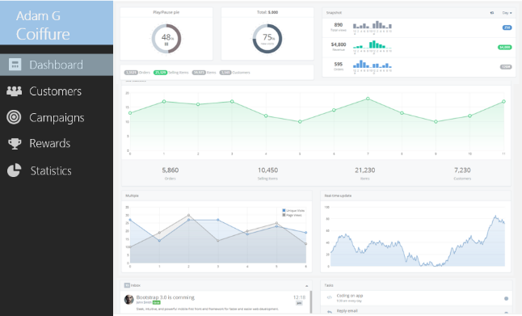

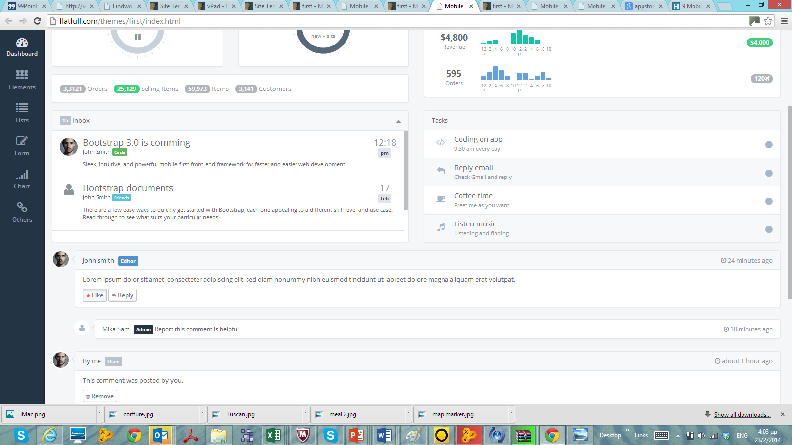
Retailer’s Web / tablet application
Retailer’s Web App
to administer all
his loyal customers
and campaigns
Adam G
Coiffure
Dashboard
Customers
Rich and easy modules
Customers spending
activities – all in one
place
Campaigns
Rewards
Statistics
Responsive UI to fit
to all screens and
browsers

Slide 5
Benefits for all
Digital Loyalty
Increase loyalty and frequency of your customer visits using the latest mobile technology.
Simple and powerful
It's easy to use and unlocks the secrets for increasing retailers revenues .
www.walleb.com
Scalable programs
Walleb will be launched soon and offers various programs for all marketing and loyalty budgets
Contact us for further information

